Slide 1

BUILDEASE
Connecting Customers and Builders for Seamless Construction Project Management

Slide 2
Team Details
Sr No | Name | Course | PRN No
1 | Madhura Halwai | PG-DAC | 240340120094
2 | Mimansha Shekhawat | PG-DAC | 240340120100
3 | Gururaj Kamble | PG-DAC | 240340120079
4 | Vallabh Jadhav | PG-DAC | 240340120072
5 | Jayesh Sapkale | PG-DAC | 240340120075

Slide 3

About Website
BuildEase is an innovative platform that simplifies construction project management by connecting customers with builders.
It offers a unified interface for customers to find builders, start projects, and manage every phase, while builders can review requests and collaborate for high-quality delivery.
Built with React.js, Spring Boot, and MySQL, BuilderEase ensures a responsive user experience, robust scalability, and secure, accessible project data.

Slide 4


Slide 5
About Our Project
Customers can create profiles and list their project requirements to find the right builders.
Builders can update their skills and expertise to connect with potential customers.
Customers can track their ongoing and previous projects through the platform.
Builders can monitor the projects they've been assigned and track progress directly through the portal.

Slide 6
Key Features
Unified Interface: Provides a streamlined experience for both customers and builders, making project initiation and management straightforward.
Builder Profiles: Allows builders to showcase their skills, experience, and past projects.
Project Requests: Enables customers to post detailed project requirements and receive proposals from qualified builders.

Slide 7
Progress Tracking and Milestones: Visual project tracking with milestone indicators helps both customers and builders monitor progress and stay on schedule.
Secure and Transparent Payments: Integrated payment gateway ensures secure transactions with payment milestones, protecting both parties.
Advanced Search and Filtering: Customers can find builders based on specific criteria such as expertise, location, ratings, and availability.

Slide 8
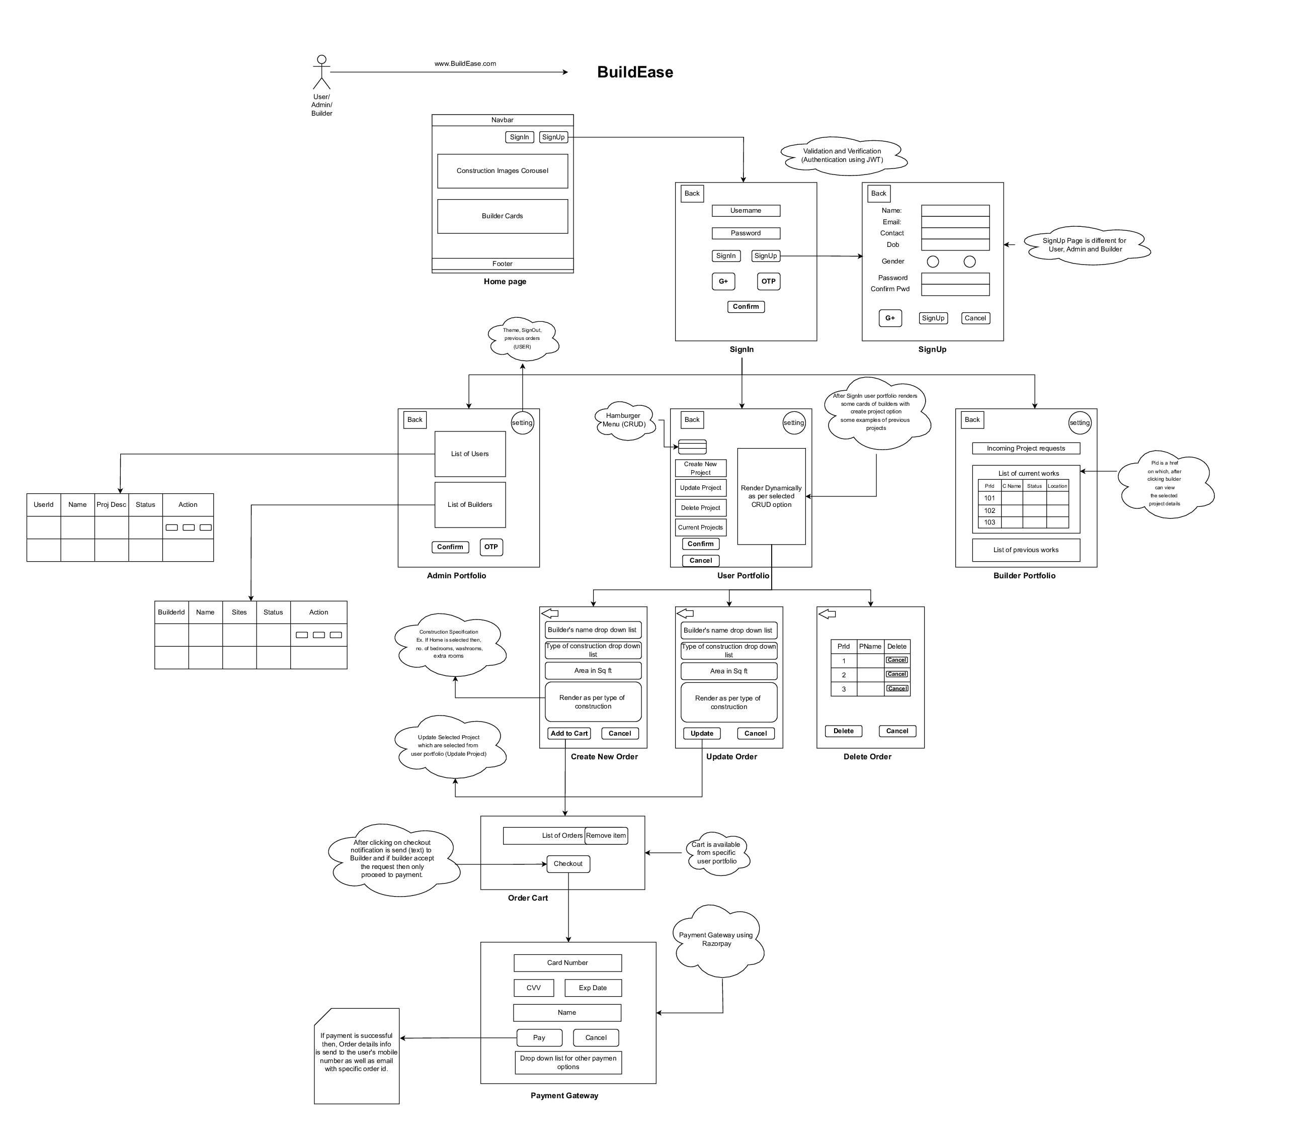
System Architecture

Slide 9
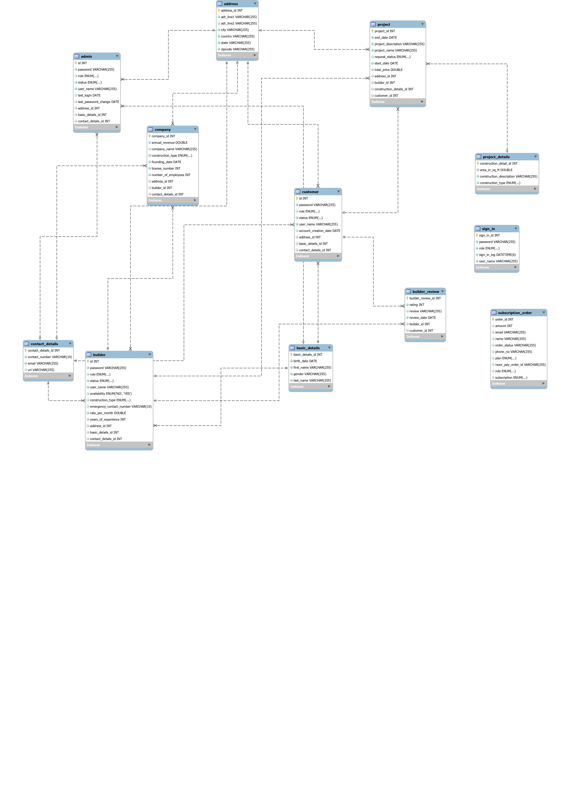
UML DAIGRAM

Slide 10
E-R DAIGRAM

Slide 11
Tech Stacks Used
React Js
CSS
SpringBoot
HTML
MySQL
GitHub

Slide 12
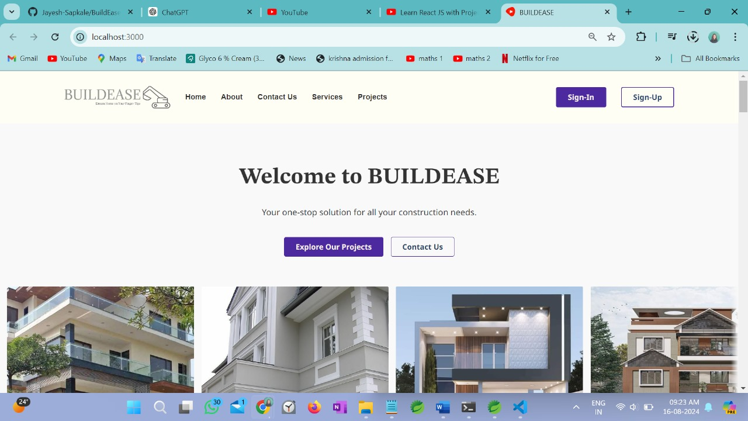
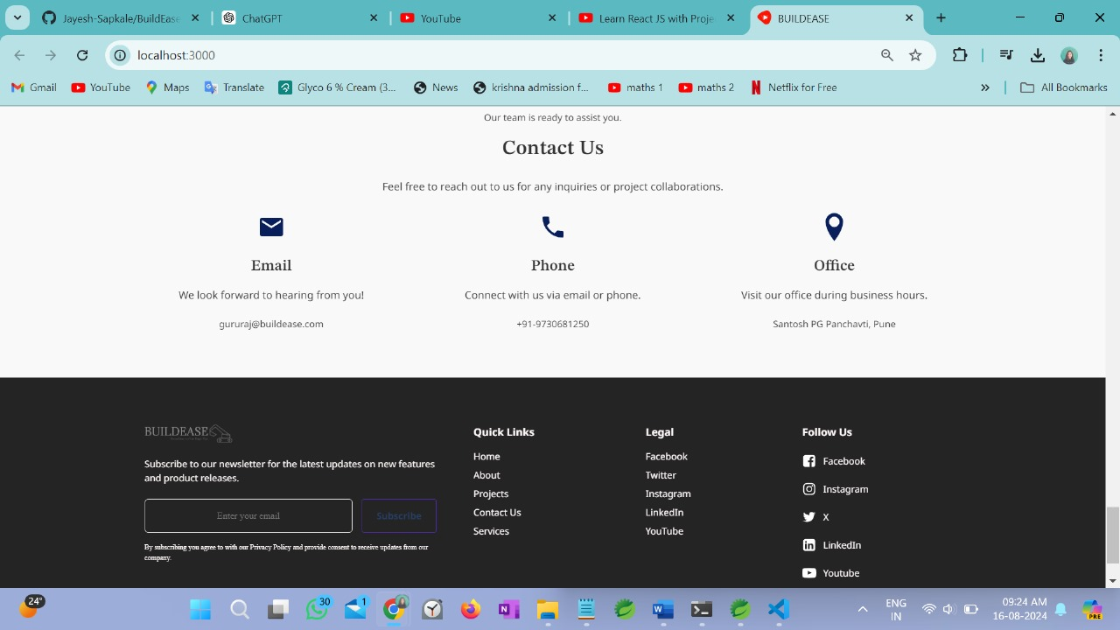
VISUALS

Slide 13
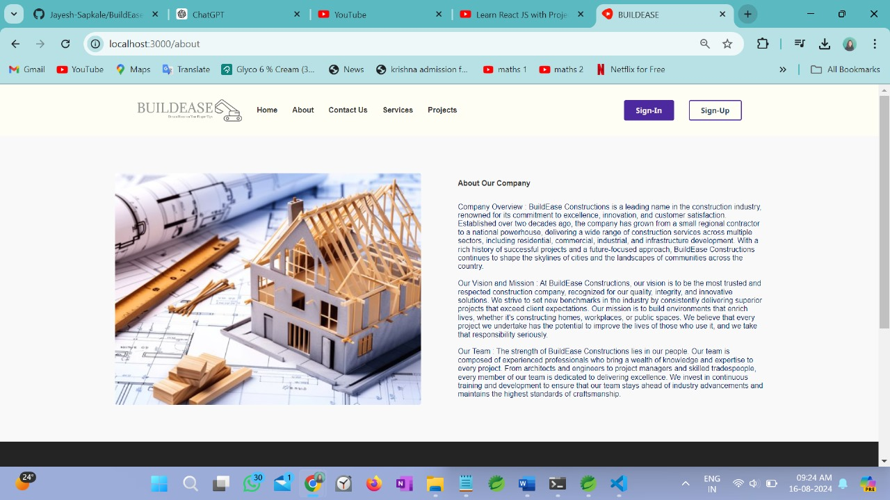
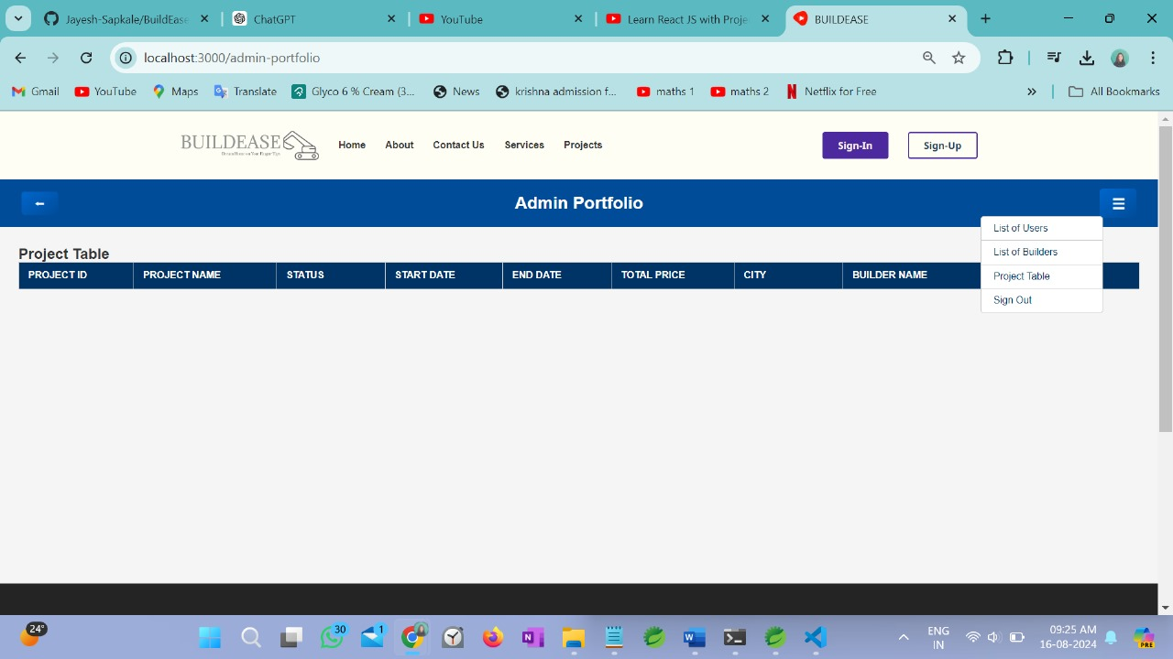

Slide 14
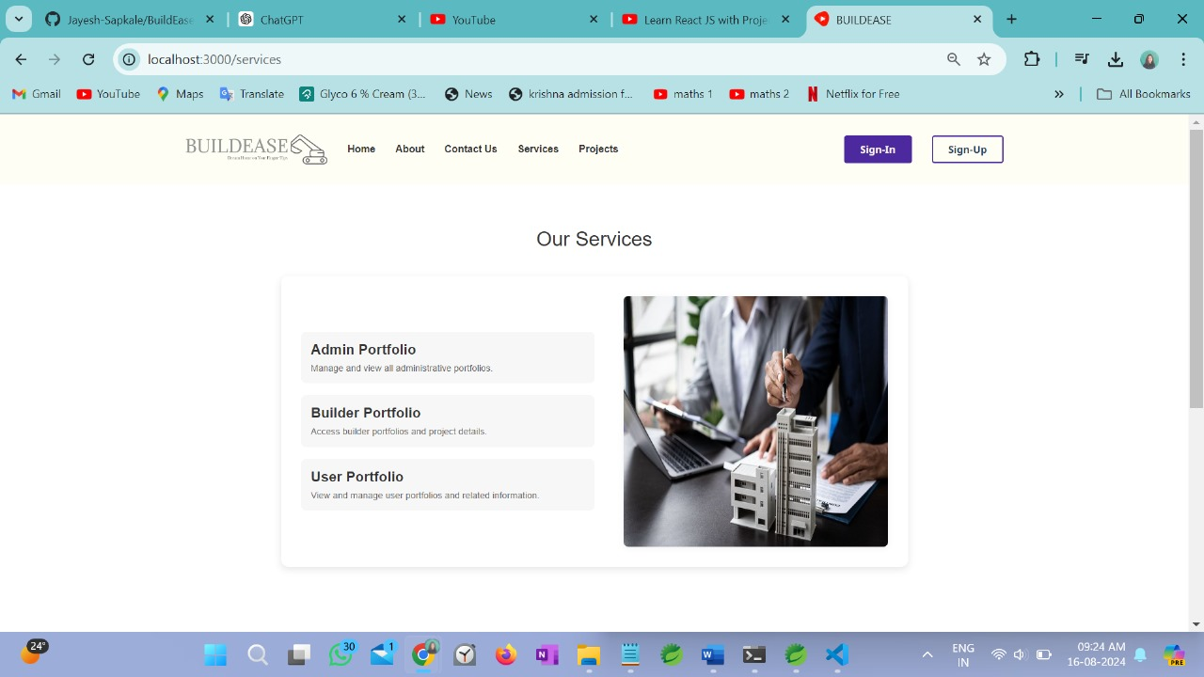
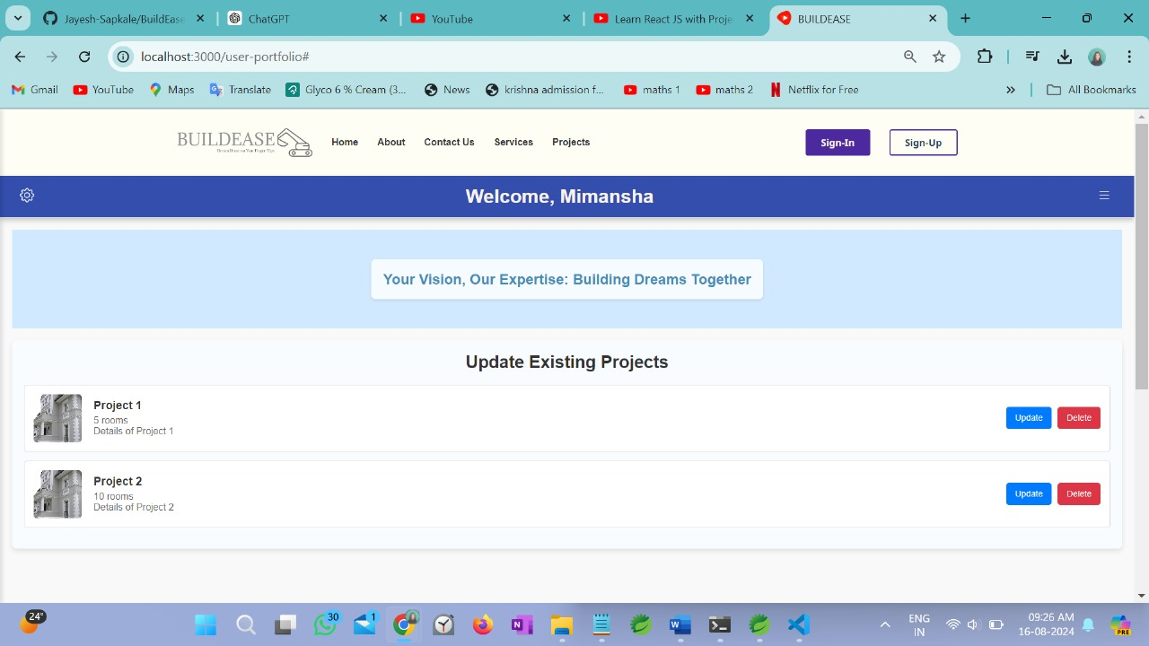

Slide 15
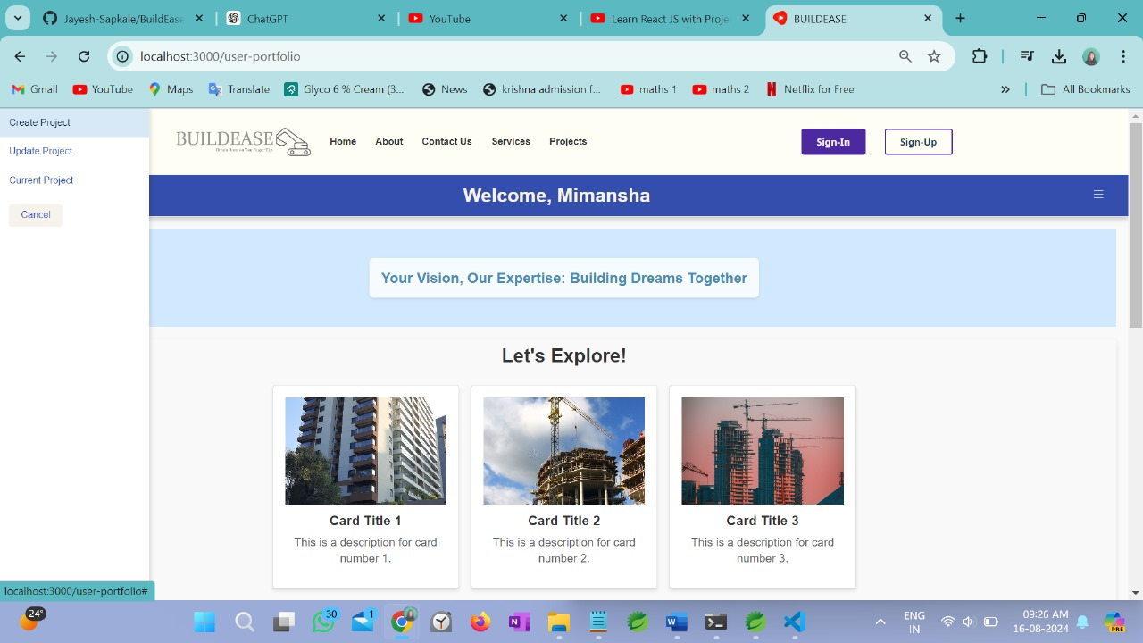
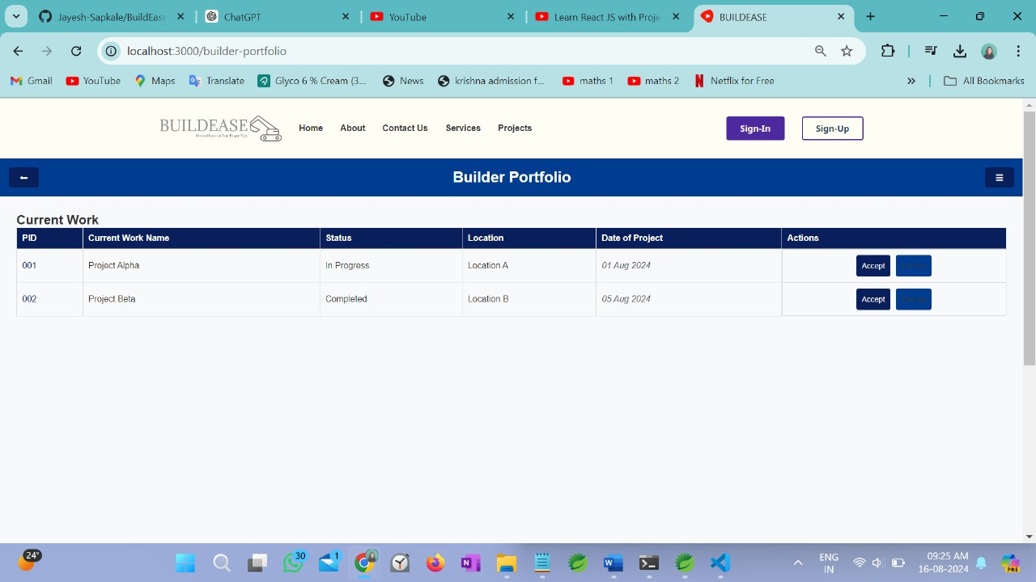

Slide 16
Future Work
Advanced Analytics: Integrate detailed reports for project timelines, costs, and performance.
Third-Party Integration: Connect with accounting tools, project management software, and communication platforms.
User Personalization: Enhance customization for profiles and project settings.
Virtual Site Visits: Introduce virtual walkthroughs for remote site monitoring.
Collaboration Tools: Add shared workspaces, document management, and multi-user access.

Slide 17
Real-Time Communication: Implement a chat system and notifications for seamless interaction.
AI Recommendations: Suggest builders based on project needs, budget, and performance.
Scalability Improvements: Optimize infrastructure to support a growing user base.
Automated Updates: Set up alerts for project milestones and deadlines
Usability: User feedback confirms a highly intuitive and user-friendly interface.

Slide 18
CONCLUSION
The BuildEase application effectively connects customers with builders, facilitating seamless construction project management. Through rigorous development and testing, the app excels in key areas:
Performance: Delivers quick response times and scalability under varying load conditions.
Functionality: Core features are fully implemented and tested for smooth navigation and task execution.

Slide 19
Security: Robust measures are in place to safeguard user data and prevent unauthorized access.
Compatibility: Consistent experience across various browsers and devices.
Overall, BuildEase successfully meets its objectives, offering a reliable and efficient platform for construction project management.

Slide 20
THANK YOU!

